Slide 1
Bipolar Junction Transistor

Slide 2
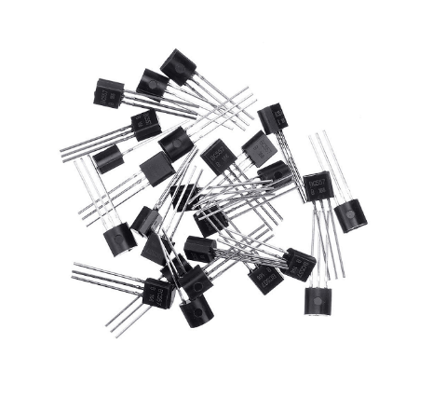
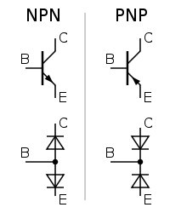
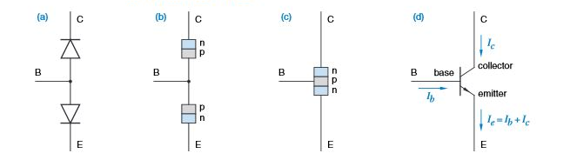
Fundamentals of Transistor
?
?
?
Lecture 32

Slide 3
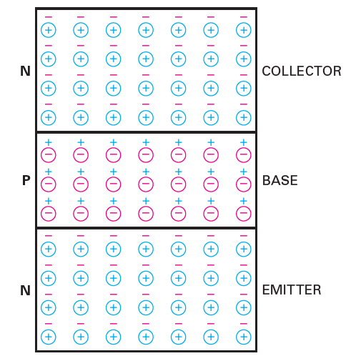
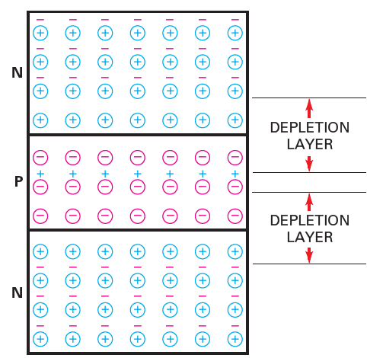
Structure of Transistor
Terminals of a BJT
Emitter
Base
Collector
What is biasing?
Setting an initial working condition for the transistor to function by applying a fixed voltage.
Lecture 32

Slide 4
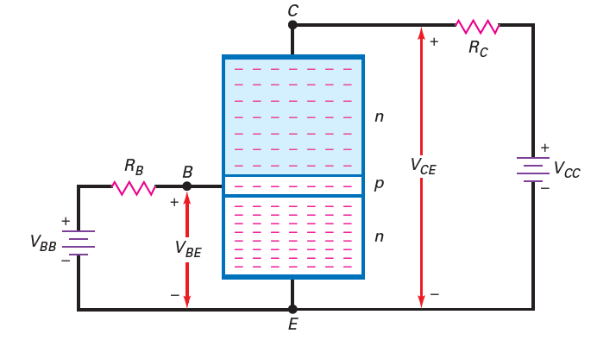
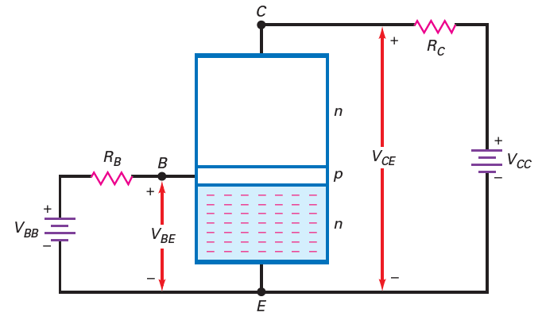
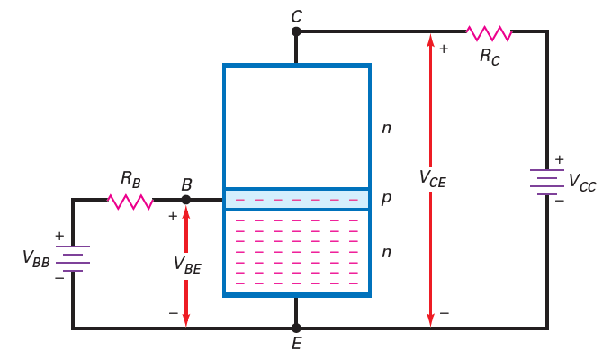
On biasing a transistor
The current will flow through different parts of the BJT
Job of emitter, base, and collector
Lecture 32

Slide 5
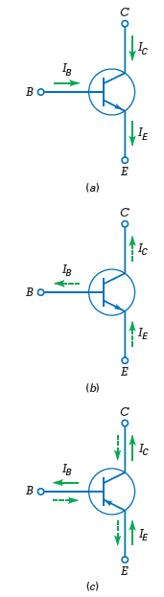
Transistor parameters
Most electron from emitter reaches collector
Less than 1% fail to reach collector
Basic current equation of BJT is I_{E}=I_{B}+I_{C} , where I_{B}<<I_{C}, I_{E}=I_{C}
Alpha and beta current gain
200 to 300 for low power and
20 to 100 for high power
(a) Conventional flow; (b) electron flow; (c) pnp currents
Lecture 32

Slide 6
Problems
A transistor has a current gain of 150 and a base current of 30 µA. What is the collector current?
Solution
with IC = βdc * IB, IC= 150*30µ = 4500µA = 4.5mA
The collector current is 10 mA, and the base current is 0.1 mA. What is the alpha dc?
solution
Total current IE=10+0.1=10.1A
αdc= 10/10.1 = 0.9901
Lecture 32

Slide 7
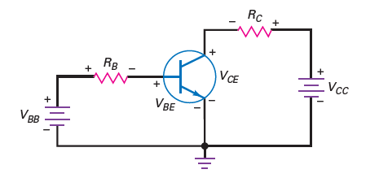
Subscript terminology
The voltage reffered in the circuit of a BJT has 2 forms
V_{yy}, V_{zz}, V_{yx}, and V_{zx}
When the subscript are the same, they refer to the voltage applied
When the subscript are different, they refer to the voltage developed across the diodes of the transistor
Third form of terminology which is used in analysis – V_{C} , V_{B} , and V_{E} , they represent the terminal voltage of the transistor
V_{CE} = V_{C} - V_{E}
V_{CB} = V_{C} - V_{B}
V_{BE} = V_{B} - V_{E}
Lecture 32

Slide 8
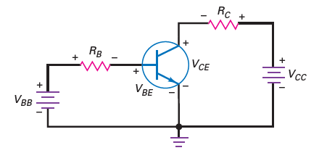
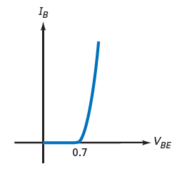
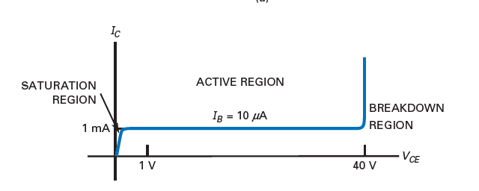
Characteristics curve
Base curve
Collector curve
Lecture 32

Slide 9
Few terms to know
Saturation region
Active region
Breakdown region
Cutoff region
Lecture 32

Slide 10
Problems
A transistor circuit has a collector supply voltage of 20 V, a collector resistance of 1.5 kΩ, and a collector current of 6 mA. What is the collector-emitter voltage?
Solution
V_{CC}=20V, R_{C}=1.5kΩ, I_{C}=6mA
V_{CC} = I_{C}R_{C}+V_{CE}
So; 20 = 1.5*10^3*6*10^-3 + V_{CE}
Therefore; V_{CE} = 11V

Slide 11
Reference
A. P. Malvino, “Electronic Principles”, 7th Edition, Tata McGraw Hill, 2007.
David A. Bell, “Electronic Devices and Circuits”, 5th Edition, Oxford University Press, 2008.
4. Michael Tooley B. A., “Electronic circuits: Fundamentals and Applications”, 3rd Edition, Elsevier Limited, 2006.

Slide 12
Thank You

